Slide 1

SirVey
ELEN7046: Software Technologies and Techniques
Team GIMP 2.0

Slide 2
Agenda
Project Initiation
Live Demo
Project Team
Prototype Scope
Solution Architecture
Individual Presentations
Future Enhancements
Notes:
Peter – Intro
Welcome to the Live demo
List Agenda

Slide 3
Project Initiation
Project Objectives
Facilitate service improvements
Transparency of the service quality
Conduct surveys
Provide stakeholder feedback
Project Vision
Notes:
Bak – Project Initiation
Project Objectives:
Facilitate service improvements
Transparency of the Service quality
Provide stakeholder Feedback
Conduct Survey’s on a regular Basis to gather data
Project Vision:
Typical User and Use Case

Slide 4
Live Demo
Notes:
Avy and Lish:
Follow Script

Slide 5
The SCRUM Team
Peter Cousins
Bakwanyana Thobela
Leslie Dobrowsky
Avanindra Singh
Lishen Ramsudh
Product Owner
Technical Experts
Scrum Master
[1]
Notes:
Peter:
Assembled the team, Agreed a way we would work namely Scrum
Methodology:
Provided us an iterative and incremental methodology
Where a development team works as a unit to reach a common goal
Challenges assumptions of the "traditional, sequential approach"
Enables teams to self-organize
A key principle is customers can change their minds

Slide 6
Prototype Scope
Mobile
Offline and Online survey Capture
Browser
Offline and Online survey Capture
Customizable Survey’s
Multiple concurrent Survey’s
User Authentication and Roles
Custom Reporting and Statistics
Real Time Survey Refresh
On device provisioning
Support for Android >= 3.2
Notes:
Peter:
Targeted specific features per channel
Planned and implemented these in our SCRUM targeting specific features in iterations

Slide 7
Application Architecture
MEAN
Stack
Web Administration
WEB Survey
Reporting
Mobile App
(Android)
Android
Mobile Database
Integration layer
Technology Listing:
AngularJS
Android APK
JSON Restful Services
Express JS
Node JS
MongoDB using mongoose
SQL Lite, realm, retrofit
HighCharts
Business Logic
Survey Database
Notes:
Peter:
Conceptual architecture would be a Classic
With a standard design pattern: model view and controller (MVC)
Reusable Services which allowed integration into 2 channels
Channels would include, Web and Mobile solutions
With Reporting including into the Web Application
The 2 DB’s the Survey is the master and the local mobile DB is a slave

Slide 8
Peter Cousins
Scrum Master
POC – Browser Solution
Successes / Challenges
Technology Learnt
Java Script, HTML5, Spring 3, Hibernate
Notes:
Decided to explore Multiple POC’s – Knowledge is power
Project Tracking
Weekly Standups
Meeting Minutes
Burn Down Charts
Timesheets
Clear Communication (Central meeting location / whatsapp / Trello)

Slide 9
Bakwanyana Thobela
Product Owner
Voice of the customer
Business Analysis
Specification by Example
Acceptance Testing
Cucumber
Notes:
As the face of the team to the stakeholders, the following are some of the communication tasks of the product owner to the stakeholders:
demonstrates the solution to key stakeholders who were not present in a normal iteration demo
announces releases
communicates team status
organizes milestone reviews
educates stakeholders in the development process
negotiates priorities, scope, funding, and schedule
ensures that the product backlog is visible, transparent, and clear

Slide 10
Lishen Ramsudh
Technical Expert
POC 1 – M.E.A.N stack
Success
Technology Learnt
AngularJS, Express JS, Node JS, MongoDB using mongoose, HighCharts, Yeoman using Angular-full stack

Slide 11



POC Considerations

Slide 12
Avanindra Singh
Initial Rails API completed but no UI.
MongoDB vs SQL (ORM problems)
Wealth of Packages available
Previous experience in Apple iOS none in Android, thus chosen to learn.

Slide 13
Mobile Applications
Cross-Platform compilation (Xamarin) vs Native compilation (Native vs iOS)
UI Static Layouts vs Dynamic programmatically defined layouts
Performance critical in design
Design must fit to allow for threading/multi-processing, and async/sync event handling

Slide 14
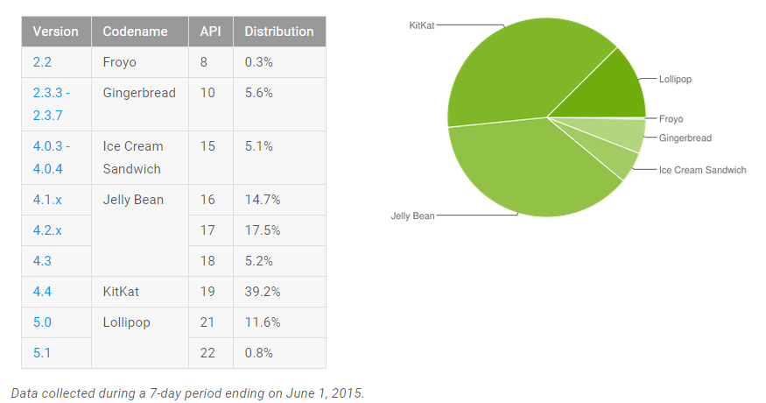
Android SDK Distribution
Reference: Android Developers Guide, http://developer.android.com/about/dashboards/index.html

Slide 15

Enter Android

Slide 16
Class Architecture
Separated into Activities
Database dependency on Activities allows UI to update the minute table is updated
Fragments Manager and Slider
Server to abstract and allow for loose coupling
Validation of user inputs
Success and Failed Event Handling, “Intent”
UML Diagram (In report ☺)

Slide 17
Challenges
Managing of resources, referencing objects, differences between API levels
Threading
Coding without using UML Layouts
Dynamic
JSON Response to Models: Survey, CompletedSurvey, QuestionAnswer\
Styling, relative vs linear layouts etc.

Slide 18
Reflections
Native development – Time, cost, resources, skills
Mobile Development environment of Dalvik and expectations are far from normal Java
Android enables creative freedom and host of libraries and tools are available.
Emulator is slow. Preferably use device

Slide 19
Leslie Dobrowsky
Technical Expert
POC – Microsoft Access / SQL Express
Achieved all POC Proof points
Challenges (Licenses / Device Compatibility)
Technology Learnt
MS Access, M.E.A.N Stack
Notes:
Leslie

Slide 20
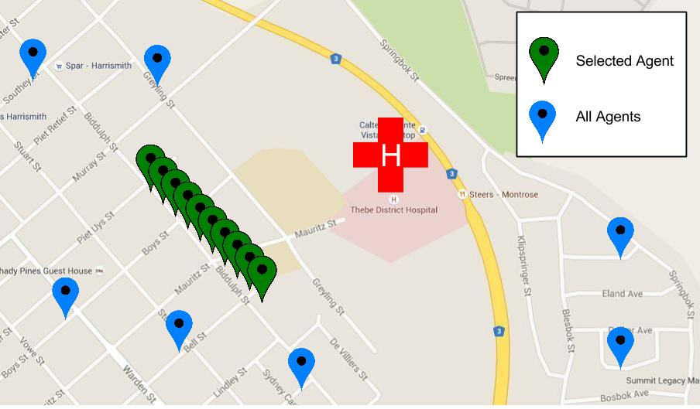
Future Enhancements
Additional official Languages
Data Encryption
Geo-Location:
Survey Agent tracking / Survey data Captured
Notes:
Leslie:

Slide 21
Conclusion
Great experience, teamwork
Conduct surveys
Provide relevant stakeholder feedback
Meets the Project Vision
Working solution
Notes:
Leslie:

Slide 22

Questions
???
Notes:
Team
Can demo on windows and Mac

Slide 23
References
[1] Rising, Linda; Janoff, N.S., "The Scrum software development process for small teams," Software, IEEE , vol.17, no.4, pp.26,32, Jul/Aug 2000

